Slide 1



FITFREAK
WWW.REALLYGREATSITE.COM

Slide 2


CONTENT
01
EMPATHIZE
02
EMPATHY MAP
03
PERSONAS AND SCENARIOS
04
DEFINE
05
IDEATE
06
PROTOTYPE
07
UNIQUE FEATURES
08
TESTING AND FEEDBACK

Slide 3
EMPATHIZE
UNDERSTANDING USER NEEDS
WWW.FITFREAK.COM

Slide 4

EMPATHIZE
CLIENT REQUIREMENTS
POSSIBLE SOLUTIONS
OUR CLIENT REACHED TO US FOR A FITNESS WEBSITE THAT SHOULD INCLUDE GYM AND YOGA FACILITIES
WE WILL EMBBED A FEATURE TO CHOOSE BETWEEN GYM OR YOGA, ALSO ADD A FEATURE TO JOIN CLASSES PER DAY

Slide 5
EMPATHY MAP
SAYS
THINK
"I want to get fit, but I don't know where to start."
"I need a workout plan that's easy to follow."
"It would be great to see my progress over time."
"I prefer workouts I can do at home."
"I need motivation to stay consistent."
"How can I fit workouts into my busy schedule?"
"Is this fitness class worth my time and money?"
"Will I be able to keep up with these exercises?"
"I hope this website has detailed guides and videos."
"Tracking my progress will keep me
. motivated."
USER
DOES
FEELS
Searches for beginner-friendly fitness
programs online.
Reads reviews and testimonials of fitness websites.
Tries out free trial workouts before committing.
Watches workout videos on social media platforms.
Uses fitness apps to track progress and set goals.
Excited about starting a fitness journey.
Overwhelmed by the variety of fitness programs available.
Anxious about staying committed to a routine.
Inspired by success stories of others.
Frustrated with past failed attempts to get fit.

Slide 6
PERSONAS AND SCENARIOS
SHUBHAM YADAV-FITFREAK USER
DOUBTS/FEAR
BACKGROUND
He wasn’t very confident with his physique.
Not very good with talking people.
got very fat.
feared that he might be body shamed
Graduated in computer science
One sibling
Working in an edtech company
Suffers from back pain
ASPIRATIONS
He wanted to be more confident.
He wanted to build his muscles.
Wants to look good.
Wants to make impressions on his friends
He wanted to impress a girl in his class so he wanted to make his physique look good.
CHALLENGES FACED
Needed a good fitness club
Wanted to communicate with other people
Wanted a yoga and gym mixed club
Wanted personalised trainer

Slide 7
ARUSH GUPTA-FITFREAK USER
BACKGROUND
DOUBTS/FEAR
Graduated in MBBS
One sibling
Working in an AIIMS Delhi.
Suffers from knee problem.
Can he get a low priced gym
Was not very comfortable with his knee problem
Got very fat.
feared that he might be body shamed
ASPIRATIONS
CHALLENGES FACED
His arthiritis could get better.
He wanted to build his muscles.
Wants to look good.
Wants to make impressions on his friends
He wanted to walk nicely with people and not feel any pain.
Had a severe knee pain
Wanted a place for workout
Was very fat
Wanted a yoga class for his arthiritis

Slide 8
PRATHAM MISHRA-FITFREAK USER
BACKGROUND
DOUBTS/FEAR
Graduated in computer science and engineering(AI)
Two sibling
Suffers from leg and back pain
He is having fear of serious illness
Uncertainty about diet and nutrition
Cocerns about weight and appereance.
Worrying about aging and degeneration.
ASPIRATIONS
CHALLENGES FACED
He wanted affordable fitness solution
He wanted to build gym confidence
Wanted to adapt strategies to maintain progress.
He wanted to overcome intimidation and feel comfortable.
Needed a balanced recovery and overtraining.
Wanted a personalised yoga and meditation instructor.
Balancing fitness with daily responsibilities.

Slide 9
SAMARTH SHUKLA-FITFREAK USER
BACKGROUND
DOUBTS/FEAR
Persuing Btech
Daily 8 hours or classes and 4 hours of self study.
Suffers from cervical and back pain due to long sitting sessions
Might get rejected due to overweight.
Overweight might led to some serious issues
Would able to manage time ater buying those expensive plans?
ASPIRATIONS
CHALLENGES FACED
Knows very well that good physique build good confidence.
Want to outstand in a group of people.
Want peace of mind for better work performance
Not able to manage time
Facing mental stress due to spending over time in front of screen.
Getting confused as different people gives different advice.

Slide 10
DEFINE PHASE
WWW.FITFREAK.COM

Slide 11
DEFINE
USER INSIGHTS
SUMMARY OF FINDINGS:
USERS NEED QUICK, EFFECTIVE WORKOUTS THAT FIT INTO THEIR BUSY SCHEDULES.
USERS PREFER PERSONALIZED FITNESS PLANS TAILORED TO THEIR GOALS AND PROGRESS.
PROGRESS TRACKING TOOLS ARE ESSENTIAL TO KEEP USERS MOTIVATED.
MOTIVATIONAL CONTENT AND COMMUNITY SUPPORT ARE VALUABLE FOR MAINTAINING CONSISTENCY.
USER NEEDS:
TIME-EFFICIENT WORKOUT ROUTINES.
PERSONALIZED FITNESS PLANS.
EASY-TO-USE PROGRESS TRACKING TOOLS.
MOTIVATIONAL CONTENT AND COMMUNITY SUPPORT.

Slide 12
PROBLEM STATEMENT (POINT OF VIEW - POV):
SHUBHAM YADAV:
Problem Statement: Shubham Yadav, a 20-year-old software engineer, needs a fitness program that integrates seamlessly into his daily routine because he spends long hours at a desk and struggles to find time for physical activity. He needs workouts that are quick and can be done in short breaks to ensure he remains active and maintains his health without compromising his work schedule.
2. Arush Gupta:
Problem Statement: Arush Gupta, a 25-year-old college student, needs a fitness program that is affordable and requires minimal equipment because he lives in a small apartment and has a limited budget. He needs exercises that can be performed in his living space and guidance on how to stay motivated and consistent despite his busy academic schedule.
3. Samarth Shukla:
Problem Statement: Samarth Shukla, a 21-year-old student, needs a fitness program that addresses his high-stress levels and focuses on both physical and mental well-being because his demanding job leads to frequent stress and burnout. He needs a balanced approach that includes stress-relief activities like yoga and meditation along with traditional workouts to improve his overall health and manage stress effectively.
4. Pratham Mishra:
Problem Statement: Pratham Mishra, a 19-year-college student, needs a fitness program that provides personalized meal plans and exercise routines because he struggles with weight management and dietary habits. He needs a holistic solution that combines nutrition counseling and fitness to help him achieve his weight loss goals and sustain a healthy lifestyle.

Slide 13
IDEATE
WWW.FITFREAK.COM

Slide 14
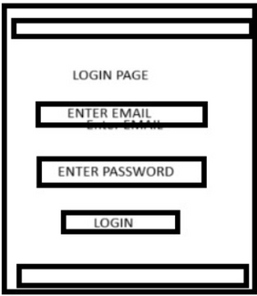
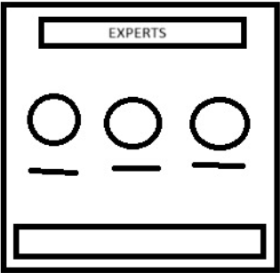
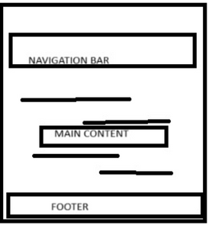


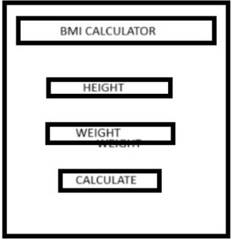
IDEATE
SOME DESIGNS FOR OUR WEBSITE
LOGIN
EXPERTS
HOME PAGE
PRIVACY
POLICY
BMI
CALCULATOR
ABOUT US

Slide 15
PROTOTYPE
WWW.FITFREAK.COM

Slide 16
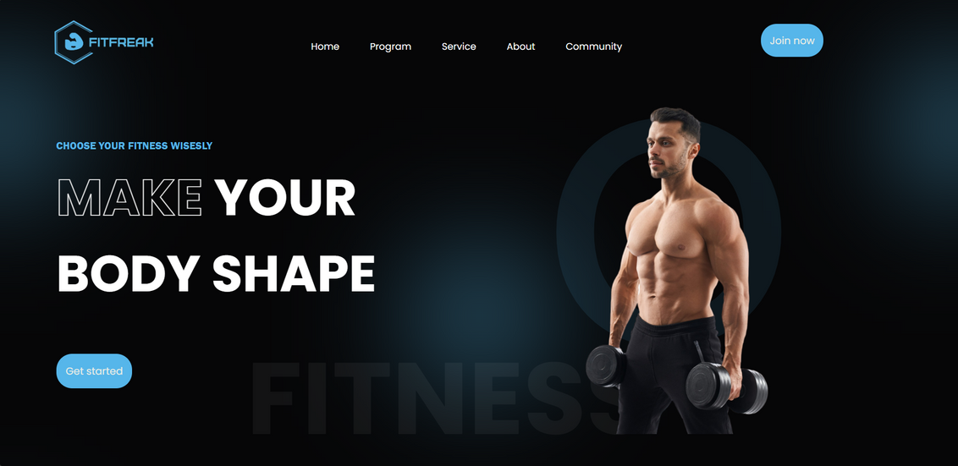
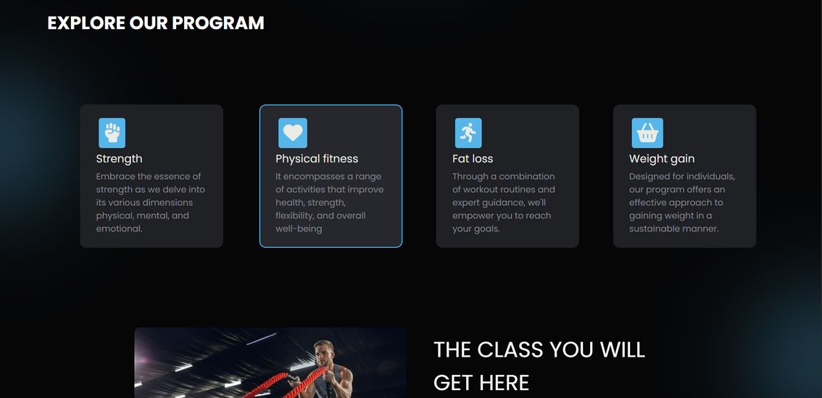
PROTOTYPE
HOMEPAGE

Slide 17
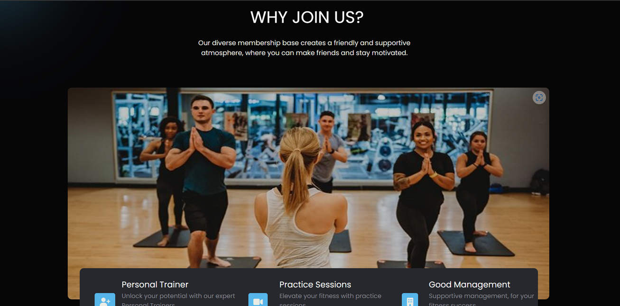
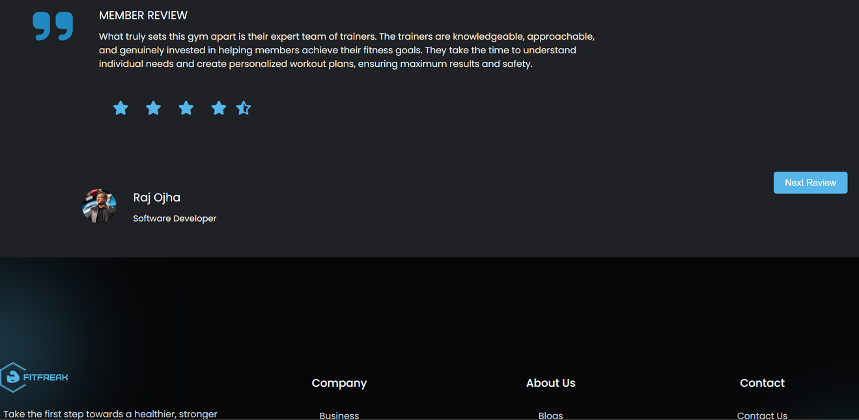

Slide 18
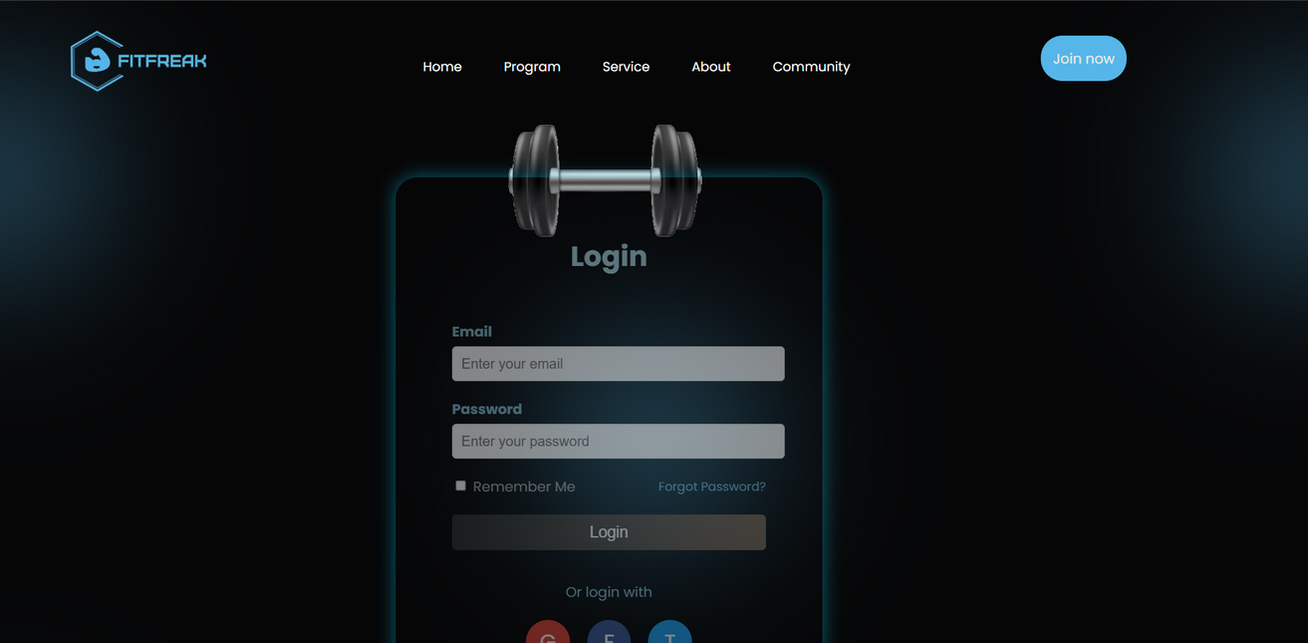
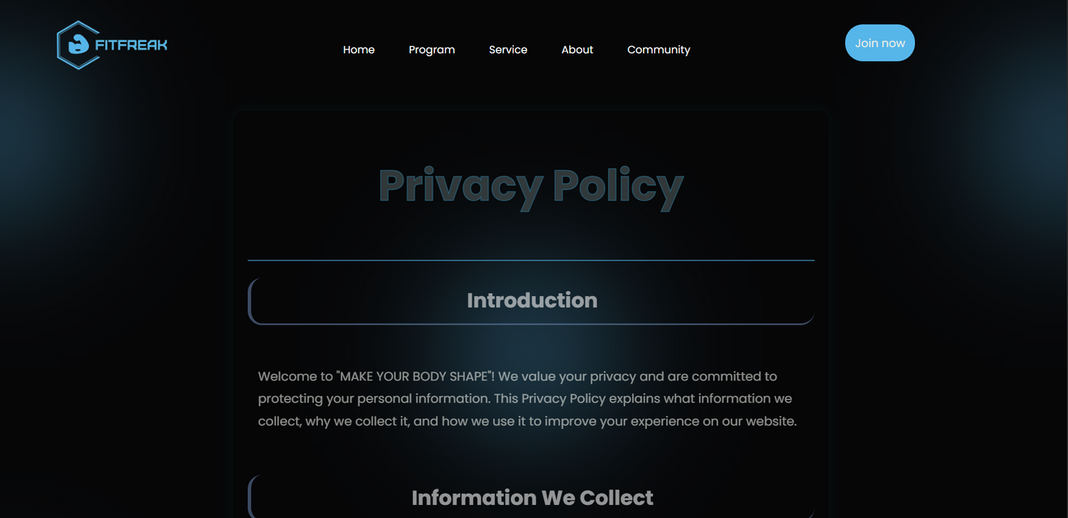
LOGIN
PRIVACY POLICY

Slide 19
UNIQUE FEATURES
CHANGING THE WAY YOU WORK
WWW.FITFREAK.COM

Slide 20
DAILY PAYMENT SYSTEM
YOU CAN PAY ONLY FOR THE DAY YOU VISITED AND CAN ALSO PAY FOR THE YOU WANT TO COME.
POST MEDICAL ASSURANCE
IF YOU GET HURT WHILE WORKING OUT OR DOING YOGA WE WILL PROVIDE YOU WITH MEDICAL ASSURANCE TO GET TREATED WITH IT.
PERSONAL MENTOR
YOU GET YOUR PERSONAL MENTOR WHO TELLS YOU HOW TO DO THE WORKOUTS AND YOGA EFFICIENTLY.

Slide 21
TESTING AND FEEDBACK
WWW.FITFREAK.COM

Slide 22
TESTING AND FEEDBACK
SHUBHAM KUMAR
SHUBHAM YADAV
COMPUTER SCIENCE
SEC-D
FEEDBACK-THE IMAGES SHOULD LOOK MORE REAL IN PROGRAM TAB
COMPUTER SCIENCE AND ENGINEERING
SEC-D
FEEDBACK-THE IMAGE IN THE HOME TAB LOOKS BLURRED

Slide 23
THANK YOU

